Slide 1

Notes:
Kenneth

Slide 2
THE
PROBLEM
Notes:
Kenneth

Slide 3
Going hungry in a hospital?
It’s easier than you think.
Notes:
Kenneth

Slide 4
"Between 20% - 50% of hospital patients experience malnutrition during a stay"
Barker LA, Gout BS, Crowe TC. Hospital malnutrition: Prevalence, identification, and impact on patients and the healthcare system. Int J Environ Res Public Health. 2011;8:514-527
“Only 8% of hospital patients are correctly diagnosed with malnutrition”
Notes:
Kenneth

Slide 5
There is NO system that can monitor the nutritional intake of 100's of hospital patients.
Notes:
Kenneth

Slide 6
OUR
SOLUTION
Notes:
Omar

Slide 7
Introducing
An AI driven, image detection system designed to combat malnutrition in hospitals
Notes:
Omar

Slide 8
How it works
At each meal, MalPal identifies what food is on the plate- then determines how much has been eaten.
If MalPal determines that a patient has consumed less than 50% of the recommended nutritional intake over the course of 4 days, then MalPal will send an alert to hospital staff.
Notes:
Omar

Slide 9

Product Demonstration
Notes:
Omar

Slide 10
VALUE
PROPOSITION
Notes:
Omar

Slide 11
Value Proposition
Helping to prevent hunger one byte at a time
Notes:
Omar

Slide 12
Why our team is the best for this problem
Notes:
Kenneth

Slide 13
The MalPal Team
CEO - Kenneth Cochran
Bioinformatics student with a passion for using AI driven image processing to combat biological problems.
CFO - Joe Siapno
Bioinformatics student with an interest in financial statistics, budget planning, and marketing strategies.
CTO - Omar Shakhtour
Senior Computer Science student with experience in web development, along with different programming languages.
Notes:
Kenneth, joe, omar

Slide 14
CUSTOMER
DISCOVERY PLAN
Notes:
Kenneth

Slide 15
Customer Discovery Plan
Reached out to 10 potential customers
5 of them worked in the healthcare industry
Questions asked included:
“Have you worked with anyone who’s experienced malnutrition?”
“Do you think it is easy to visually identify malnutrition in a person?”
“Have you tried to keep track of a person’s nutritional intake before?”
Notes:
Kenneth

Slide 16
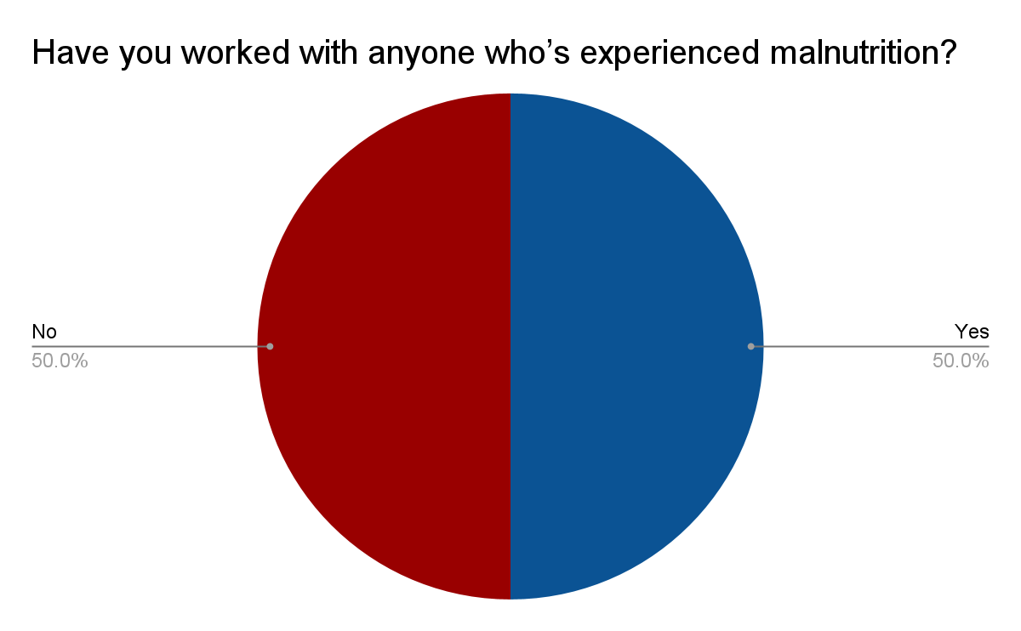
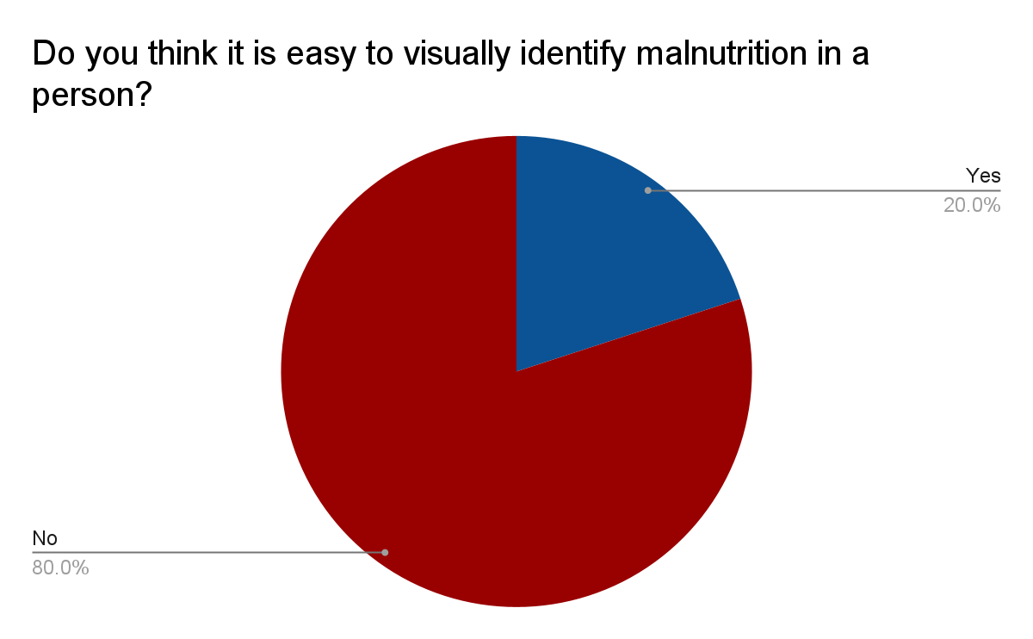
Customer Discovery Data
Notes:
Kenneth

Slide 17
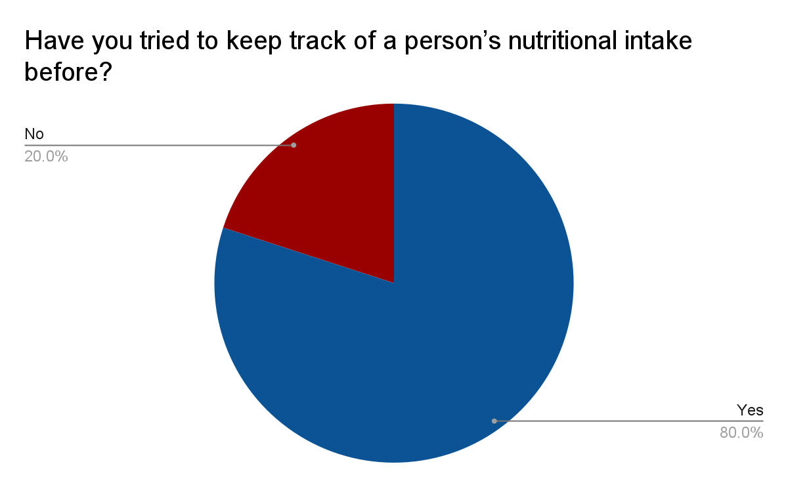
Customer Discovery Data
Notes:
Kenneth

Slide 18
ECOSYSTEM
Notes:
Joe

Slide 19
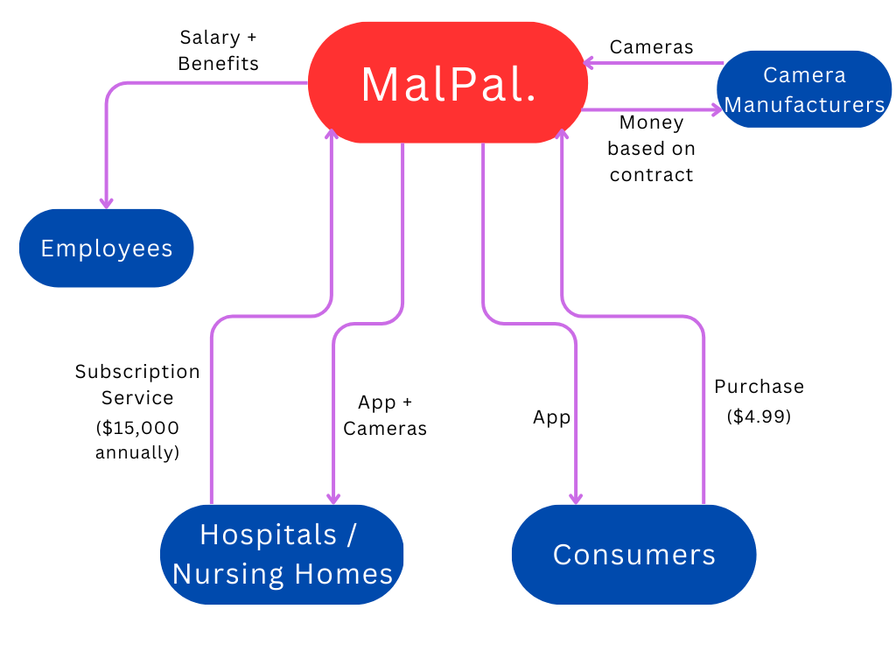
Ecosystem
Notes:
Joe

Slide 20
COMPETITORS
Notes:
Omar

Slide 21
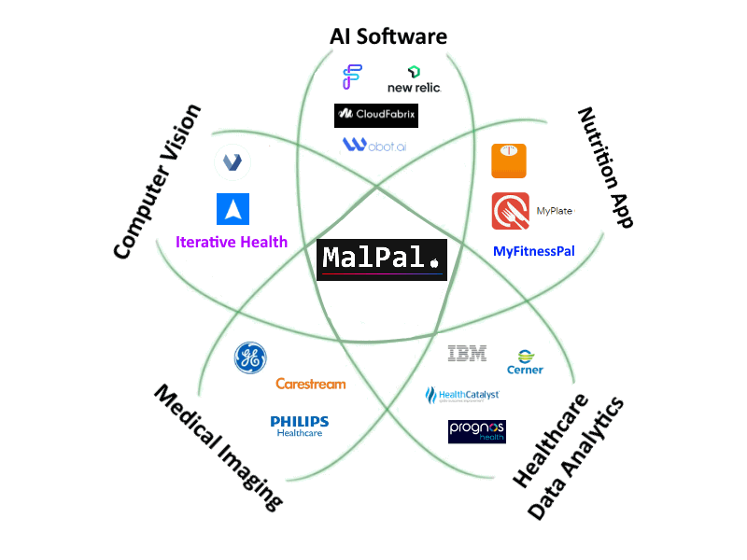
Competitors
Notes:
Omar

Slide 22
MILESTONES
Notes:
Joe

Slide 23
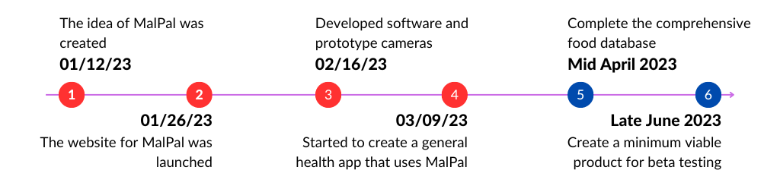
Milestones
Notes:
Joe

Slide 24
BUDGET
Notes:
Joe

Slide 25
We are looking for $300,000 and offer 20% stake in our company.
Notes:
Joe

Slide 26
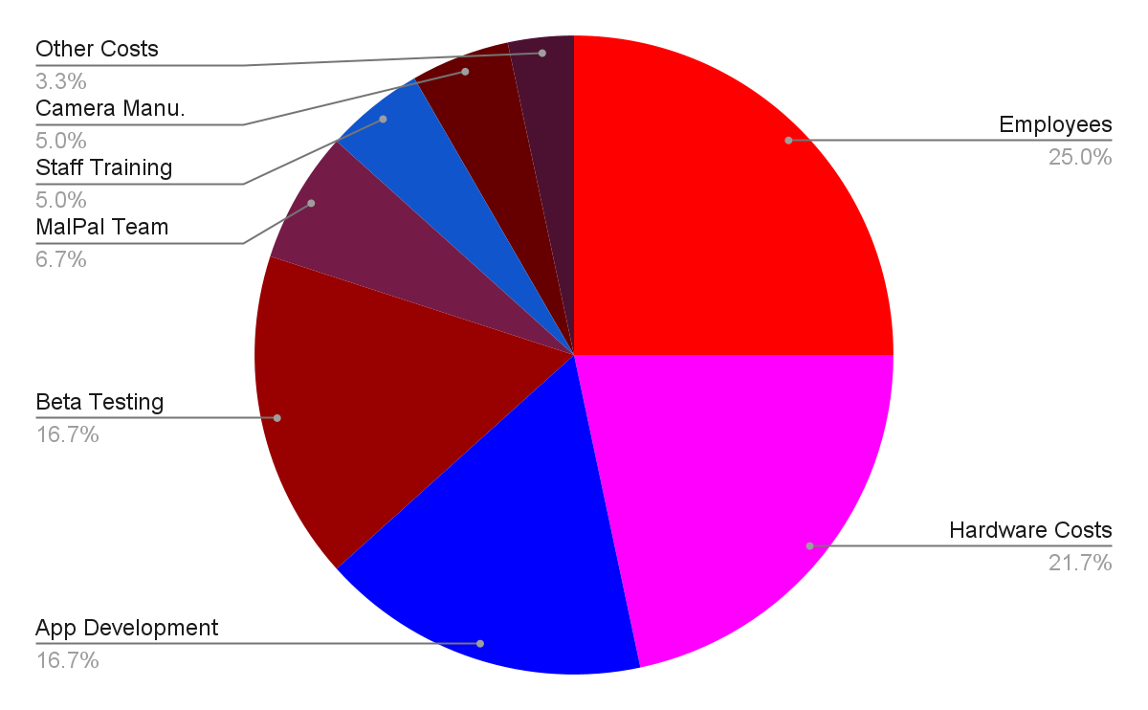
Budget
Notes:
Joe

Slide 27
Thank you!
Notes:
Kenneth

Slide 28
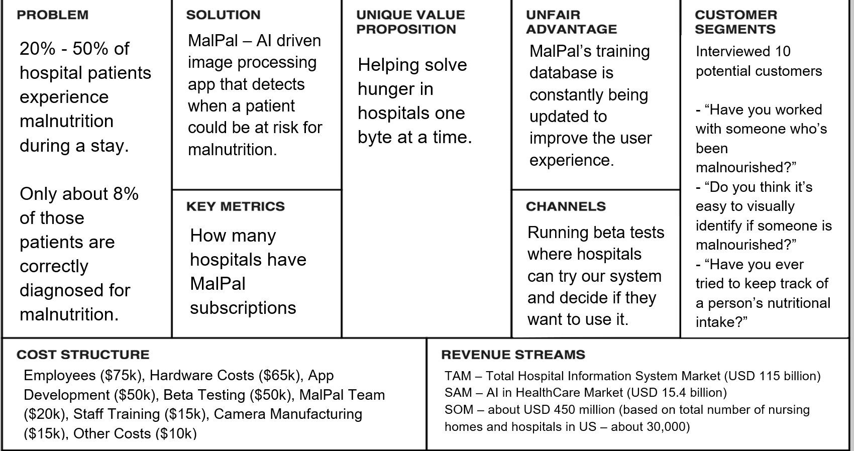
Lean Canvas Model
Notes:
Joe

